Slide 1

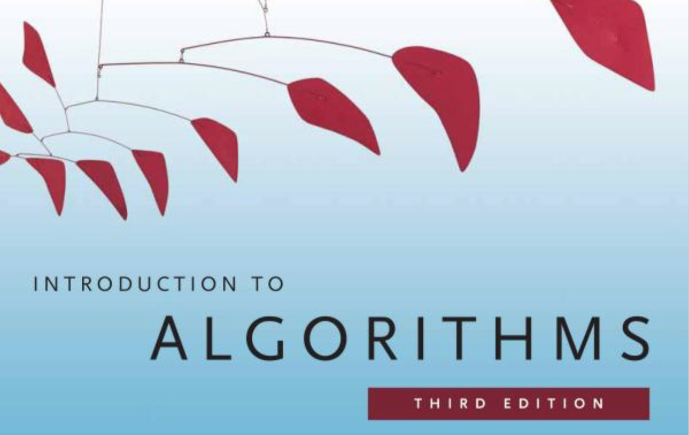
1. The Role of Algorithms in Computing
鮑興國 博士
臺灣科技大學資工系
Thomas H. Cormen, Charles E. Leiserson, Ronald L. Rivest, Clifford Stein

Slide 2
1.1 Algorithms
Algorithm: Any well-defined computation procedure that takes some value, or set of values, as input and produces some value, or set of values, as output;
Or: any tool which can solve a well-specified computational problem.
Example: Sorting problem
Input: A sequence of n numbers ⟨a₁, a₂, …, a_{n}⟩ ,
Output: A permutation ⟨a₁’, a₂’, …, a_{n}’⟩
of the input sequence s.t. a₁’ ≤ a₂’ ≤ ··· ≤ a_{n}’ .

Slide 3
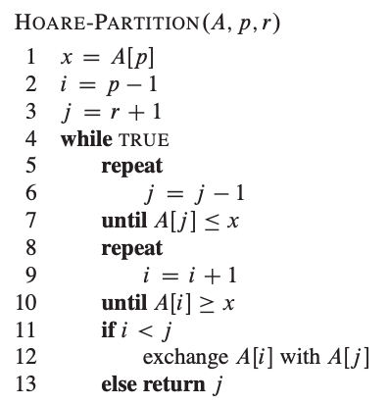
Which One is an “Algorithm”?
int partition_hoare(int a[], int lo, int hi)
{
int i, j, pivot;
pivot = a[lo];
i = lo - 1;
j = hi + 1;
for(;;) {
do {i++;} while (a[i] < pivot);
do {j--;} while (a[j] > pivot);
printf("i=%d, j=%d\n", i, j);
if (i < j)
swap(a[i], a[j]);
else return j;
}
}

Slide 4
1.1 Algorithms (cont.)
An instance of a problem consists of all inputs needed to compute a solution to the problem.
An algorithm is said to be correct if for every input instance, it halts with the correct output.
A correct algorithm solves the given computational problem.
An incorrect algorithm might not halt at all on some input instance;
=> f (x)↑ for some x∈X
Or it might halt with other than the desired answer.
=> f (x) = y, but y is not what we want

Slide 5
What kind of problem can be solved by algorithm?
The Human Genome Project
The Internet Applications
Electronic Commerce with Public-key cryptography and digital signatures
Manufacturing and other commercial settings

Slide 6
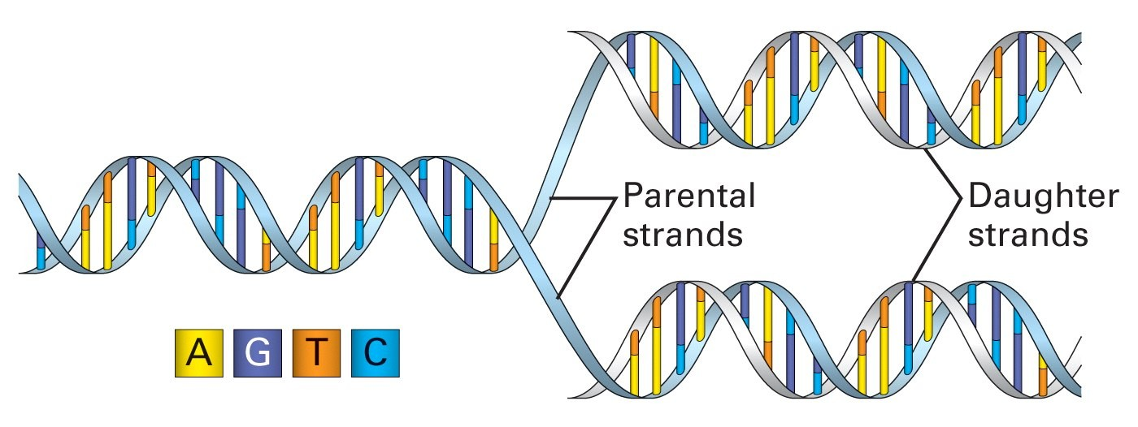
DNA: The Code of Life
The structure and the four genomic letters code for all living organisms
Adenine, Guanine, Thymine, and Cytosine which pair A-T and C-G on complimentary strands.

Slide 7
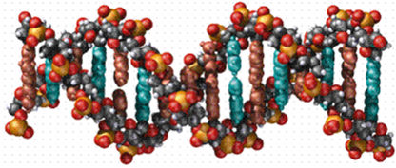
Align Two Strings
Given the strings of DNA
v = ATGTTAT
w = ATCGTAC
One Possible Alignment of the strings:
AT-GTTAT-
ATCGT-A-C

Slide 8
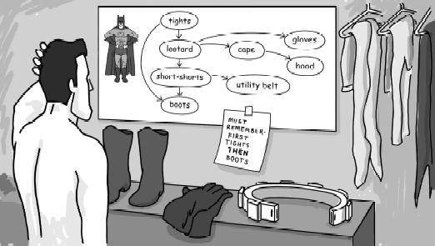
DAG: Directed Acyclic Graph
DAG for Dressing in the morning problem

Slide 9
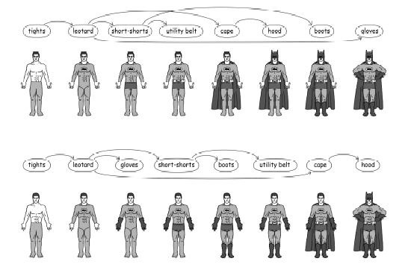
Topological ordering
2 different topological orderings of the DAG

Slide 10
Simplified Google Search Engine
How to rank the pages in the preferred order?
How to make the search as fast as possible?
How to collect as many pages as possible?
Crawler
URL Server
Store Server
Anchor
Repository
URL Resolver
Indexer
Lexicon
Barrels
Links
Doc Index
Sorter
PageRank
Searcher

Slide 11
What kind of problem cannot be solved by algorithm?
The problems proved to be unsolvable:
E.g., halting problem: to write an algorithm A taking any program P as an input and checking whether this program P will halt (output ‘yes’) or not (output ‘no’) eventually.
NP hard: Problems can be solved in an algorithmic way, but inefficiently
Problems
×
Solvable Problems
P: Problems can be solved
efficiently & algorithmically

